Slide 1
Java – Design Patterns
Sept 13, 2016

Slide 2
Singleton Design Pattern
Factory Pattern
Strategy Pattern
Command Pattern
Visitor Pattern
Adaptor Pattern
Prototype Pattern
MVC Pattern

Slide 3
Objectives
Learn about the existing design patterns which are actually quality solutions for some specific situation.
Learn how to apply these design patterns in specific situation.
Learn what could have been implications/pitfalls of avoiding them.
You would be able to write extendible and scalable code solution.
Get to know how to introduce loose coupling in different modules and components.

Slide 4

Singleton Pattern
The Singleton Pattern ensures a class has only one instance, and provides a global point of access to it.
Singleton is Creational Pattern.
Examples
There should only be one printer spooler, irrespective of printers.
There should be only one instance of a WindowManager.
There should be only one instance of a filesystem.
How do we ensure that a class has only one instance and that the instance is easily accessible?
A global variable makes an object accessible, but does not keep you from instantiating multiple objects.
A better solution is to make the class itself responsible for keeping track of its sole instance. The class ensures that no other instance can be created (by intercepting requests to create new objects) and it provides a way to access the instance.

Slide 5
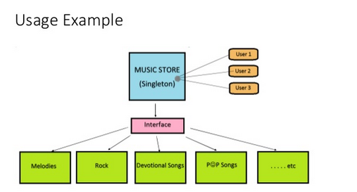
Singleton Pattern Usage
Use the Singleton pattern when
There must be exactly one instance of a class, and it must be accessible to clients from a well-known access point.
When the sole instance should be extensible by subclassing, and clients should be able to use an extended instance without modifying their code.
Example-

Slide 6
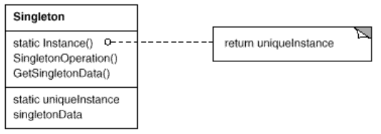
Singleton Structure
Below is the structure and class diagram of singleton class.
Singleton
static Instance()
SingletonOperation()
GetSingletonData()
static uniqueinstance
singletonData
return uniqueinstance

Slide 7
Singleton Consequences
Controlled access to sole instance
Because the Singleton class encapsulates its sole instance, it can have strict control over how and when clients access it.
Reduced name space
The Singleton pattern is an improvement over global variables. It avoids polluting the name space with global variables that store sole instances.
Permits refinement of operations and representations
The Singleton class may be subclassed and it is easy to configure an application with an instance of this extended class at run-time.
More flexible than class operations
An alternative is to use static member functions. However it is difficult to change the design to allow more than one instance of a class and static member functions are not polymorphic, so subclasses can not override them.

Slide 8
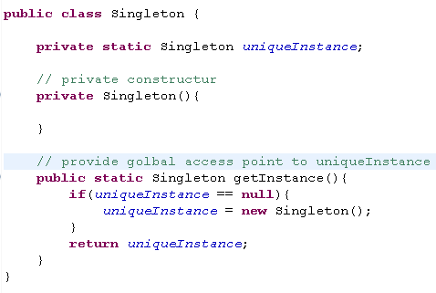
Singleton Implementation
Control the instantiation from outer world – make constructor private.
Provide global access points to all clients – a static method which return the instance.
Problem with above code – Can break in case of multi threaded environment.

Slide 9
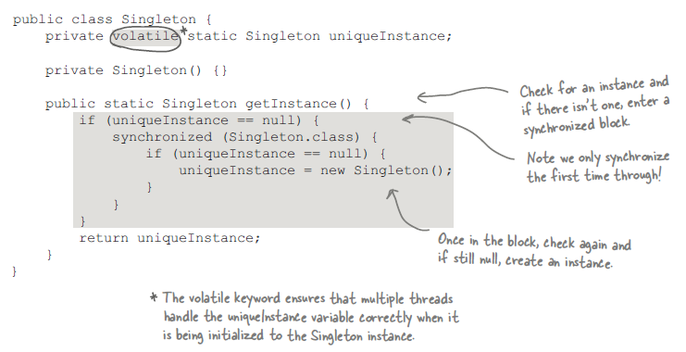
Singleton Implementation- Thread Safe
Below Singleton implementation will work in multi threaded environment.
This is called Double check locking (DLC implementation) to reduce the use of synchronization in getInstance() method.

Slide 10
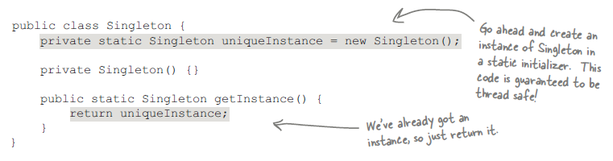
Eager Initialization
Another implementation of singleton can be eagerly created instance rather than lazily created one.
This way we can avoid synchronization.
Using this approach, Singleton instance will be created when the class is first loaded.
It guarantees that singleton instance will be available before any thread accesses the static uniqueInstance variable.

Slide 11
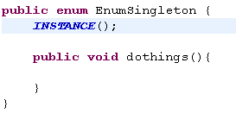
Enum implementation of Singleton
As of release 1.5, there is third approach to implementing Singleton, simply make an enum type with one element
It is very concise.
Provides serialization machinery for free.
Not widely adopted, but this is the BEST approach to implement singleton.

Slide 12
Exercise
write a class (ConnectionFactory) which implements singleton pattern defining database connection configuration statements and methods to make connection to the database.
Reason for making this class as singleton is, we can create one object of this class and can create many Connection objects (one factory, many objects).
Solution

Slide 13
Singleton over static classes
One might think that same thing could have been achieved by static classes. But Singleton has many advantages over static classes
Static classes don’t promote inheritance. If your class has some interface to derive from, static classes makes it impossible.
You cannot specify any creation logic with static methods.
Static methods are procedural code.

Slide 14
Negative sides of Singleton
They deviate from the Single Responsibility Principle. A singleton class has the responsibility to create an instance of itself along with other business responsibilities. However, this issue can be solved by delegating the creation part to a factory object.
Singleton classes cannot be sub classed.
Singletons can hide dependencies. One of the features of an efficient system architecture is minimizing dependencies between classes.

Slide 15
Best practices for Singleton
Singleton classes must be memory-leak free. The instance of the singleton class is to be created once and it remains for the lifetime of the application.
A real singleton class is not easily extensible.
Derive the singleton class from an interface. This helps while doing unit testing (using Dependency Injection).

Slide 16
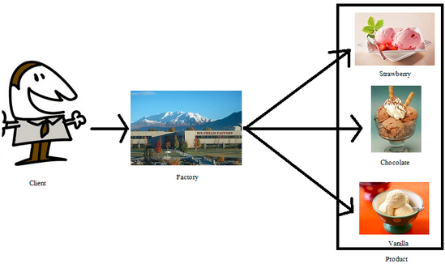
Factory Pattern
Comes under creational pattern.
Provide facility to create objects without exposing the creation logic to the client and refer to newly object using a common interface.
It has a factory method which handles the object creation.

Slide 17
Factory Pattern
Consider below example
Many instantiations makes updates and hence maintenance is difficult and error-prone.
Duck duck;
if (picnic) {
duck = new MallardDuck();
} else if (hunting) {
duck = new DecoyDuck();
} else if (inBathTub) {
duck = new RubberDuck();

Slide 18
Instantiating Concrete Classes
Using new instantiates a concrete class.
Concrete classes are often instantiated in more than one place.
Thus, when changes or extensions are made all the instantiations will have to be changed.
Such extensions can result in updates being more difficult and error-prone.
Problem Statement
Suppose that you are required to develop a system that accepts orders for pizzas. There are three types of pizzas, namely, cheese, Greek, and pepperoni. The pizzas differ according to the dough used, the sauce used and the toppings.

Slide 19
Class Diagram
Class Diagram
Here PizzaStore creates different types of pizzas.

Slide 20
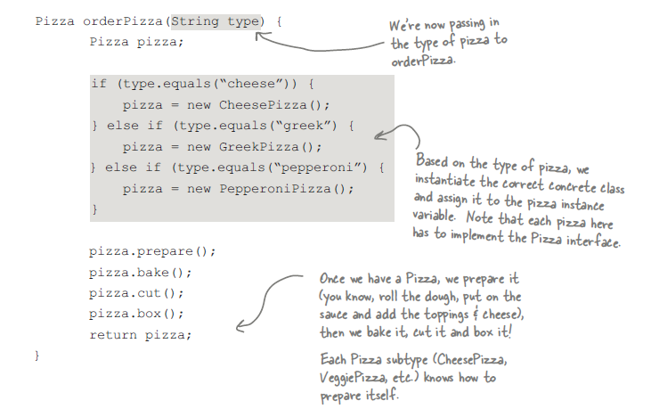
Pizza Factory Implementation

Slide 21
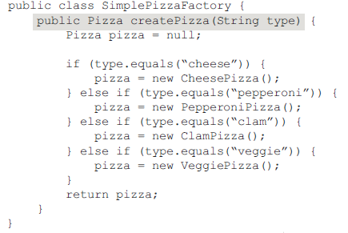
Problems
What if greek pizza is not like much and we need to remove it.
Also there are two other pizzas we need to add.
In both the cases the code is not closed for modification. We have to get into orderPizza() method code and modify it for new offerings and remove one.
Solution:
Encapsulate what changes (object or pizza creation here) out of orderPizza method and let’s call it SimplePizzaFactory

Slide 22
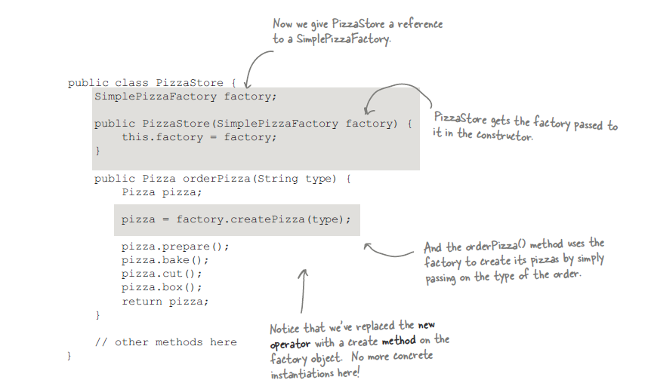
Reworking on Pizza store

Slide 23
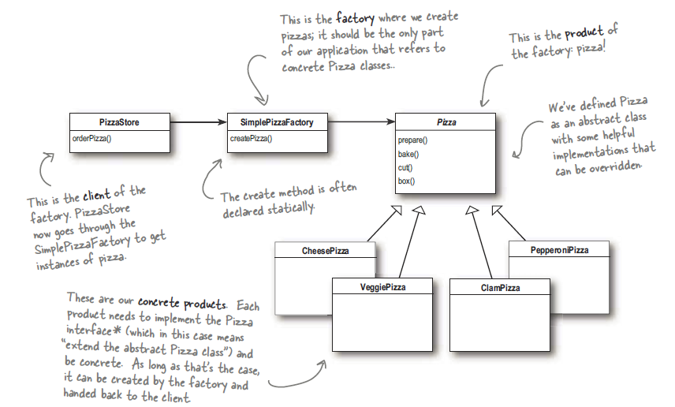
This is Simple Factory pattern.
For Pizza Store, this is how our simple factory pattern looks like

Slide 24
Franchising the Pizza store
Franchises in different parts of the country are now adding their own special touches to the izza. For example, customers at the franchise in New York like a thin base, with tasty sauce and little cheese. However, customers in Chicago prefer a thick base, rich sauce and a lot of cheese. Some franchises also cut the pizza slices differently (e.g. square)
You need to extend the system to cater for this.
# New Class diagram of Creator class-

Slide 25
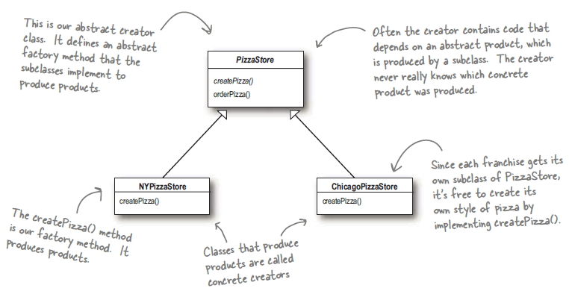
Solution
The creator classes

Slide 26
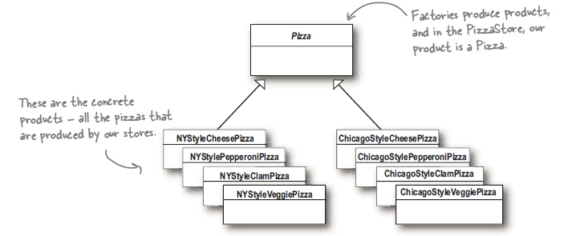
The product classes

Slide 27
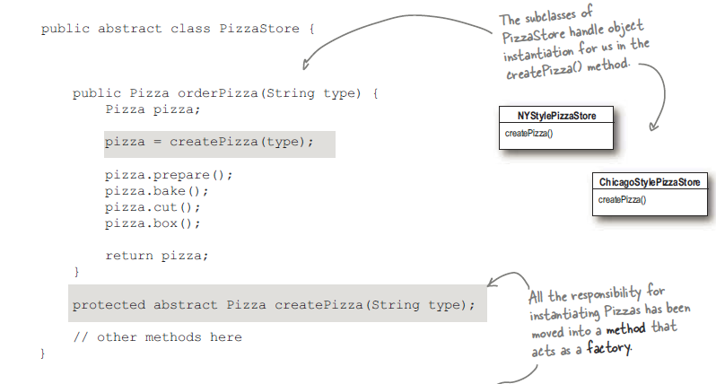
Implementation – Abstract PizzaStore

Slide 28
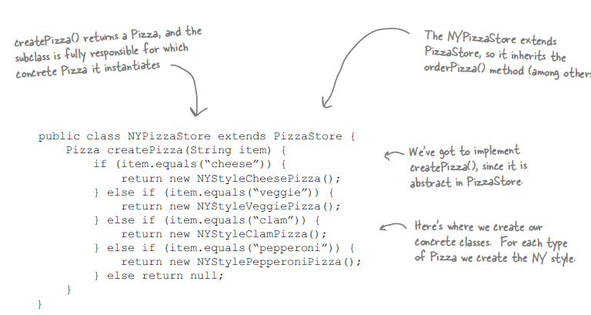
Concrete NewYorkStylePizzaStore

Slide 29
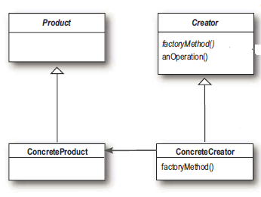
Factory Method Pattern
Official definition-
The factory method pattern defines an interface for creating an object, but let’s subclasses decide which class to instantiate.
It defines a parallel class hierarchy.
The creator class is written without the knowledge of the actual products that will be created, which is decided purely by the choice of subclass that is used.

Slide 30
Summary
The creator gives you an interface for writing objects.
The creator specifies the “factory method”, e.g. the createPizza method.
Other methods generally included in the creator are methods that operate on the product produced by the creator, e.g. orderPizza.
Only subclasses implement the factory method
Parting thoughts
When you have code that instantiates concrete classes that may change, encapsulate the code that changes.
The factory pattern allows you to encapsulate the behaviour of the instantiation.
Duplication of code is prevented.
Client code is decoupled from actual implementations.
Programming to interface not implementation.

Slide 31
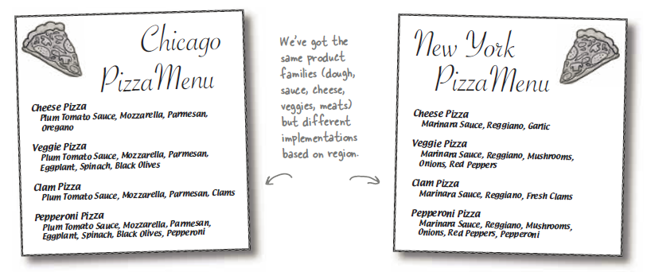
Abstract Factory Pattern
Extend the PizzaStore further-
Each franchise is using their ingredients (Sauce, Cheese, Veggies etc.) but you want to make sure the quality. You are going to build a factory that produces them and ships them.
There is one problem with the plan. The franchisee are located in different locations. So what is red sauce in New York is not red sauce in Chicago.

Slide 32
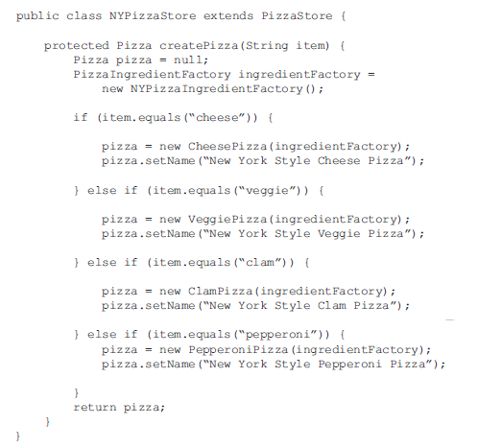
Revisiting the PizzaStore

Slide 33
What we did
We provided a means creating a family of ingredients for pizzas by introducing a new type of factory called as Abstract Factory.
By writing code that uses this interface, we decouple our code from the factory that actually creates the products.
From abstract factory, we derive one or more concrete factories that produces the same product with different implementations.
Because our code is decoupled from the actual products, we can substitute different factories to get different behavior.

Slide 34
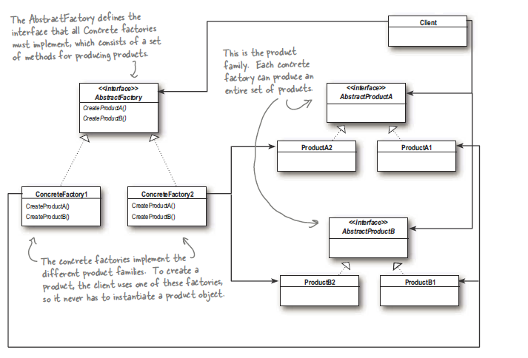
Abstract Factory pattern Defined
The abstract factory patterns provides an interface for creating families of related and dependent objects without specifying their concrete classes.
See the class diagram-

Slide 35
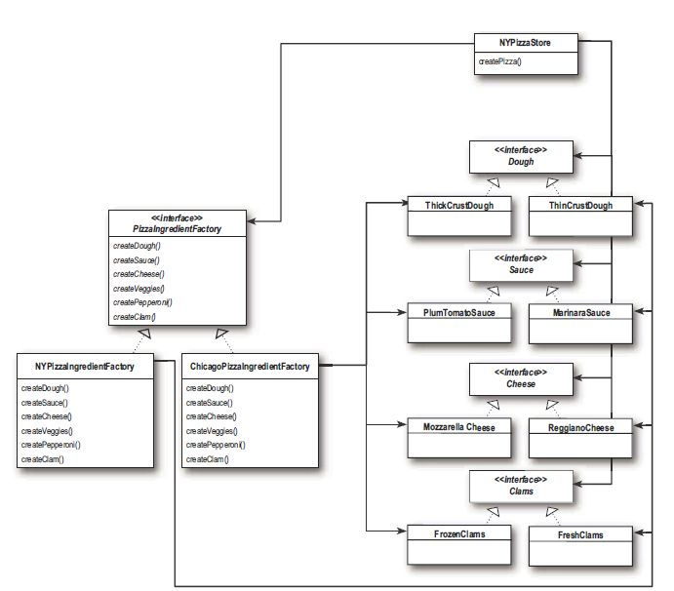
Applying Abstract Factory to new Pizza Store
Factory- Provides an interface to create one product
Abstract Factory- Provides an interface to create a family of products

Slide 36
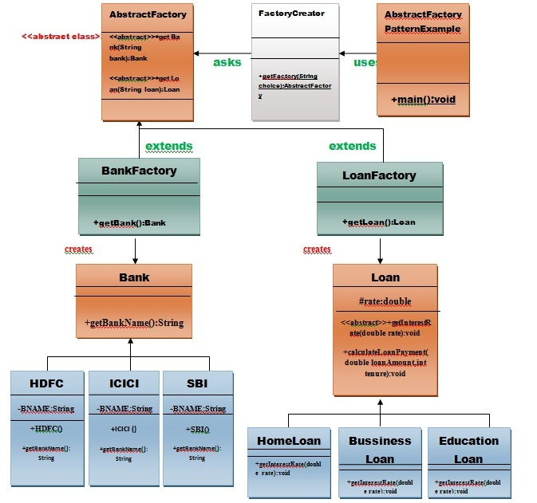
Exercise
create a Bank interface and a Loan abstract class as well as their sub-classes.
create AbstractFactory class as next step
create concrete classes, BankFactory, and LoanFactory that will extends AbstractFactory class
AbstractFactoryPatternExample class uses the FactoryCreator to get an object of AbstractFactory class.

Slide 37
Benefits and Flaws of AbstractFactory
Benefits
It isolates the creation of objects from the client. Introduce loose coupling.
Makes the implementation easier.
The exchanging of products family is easier, as the class of a concrete factory appears in the code only where it is instantiated.
If any product class changes (it’s constructor or something) client class don’t have any impact. Only factory class is changed.
Promotes consistency among objects.
Flaws
Adding new products to the existing factories is difficult as Abstract Factory interface uses a fixed set of products that can be created.
Adding a new product would mean extending the factory interface, which involves changes in the AbstractFactory class and all its subclasses.

Slide 38
Strategy Pattern - How to design for flexibility
Consider a duck application-
All ducks quack and swim. The superclass takes care of the implementation code
Duck
quack(){ }
swim() { }
abstract display()
//other duck-like methods…
The display() method is abstract, since all duck subtypes look different
Each duck subtype is responsible for implementing its own display() method
Other duck types inherit from the Duck class
. . .
MallardDuck
display() {
// looks like a mallard}
RedHeadDuck
display() {
// looks like a redhead }

Slide 39
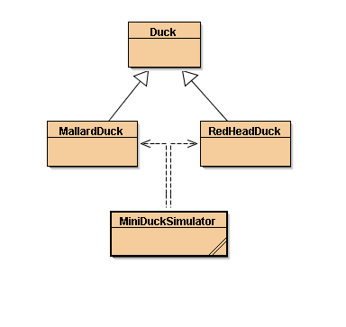
Inheritance used
All subclasses inherit the superclass’ properties
Variables and Methods
Inheritance UML diagram-

Slide 40
But Executive wants to add fly functionality quickly.
The executive wants fly functionality to be added quickly like in two days.
Solution #1
Add a fly() method in super class duck.
Continue to use inheritance.
Duck
quack()
swim()
display()
fly()
//other duck-like methods…
All subclasses inherit fly()
MallardDuck
display() {
// looks like a mallard}
RedHeadDuck
display() {
// looks like a redhead }

Slide 41
Everything OK?
Think harder
Something serious wrong.
Add a new Rubber Duck in hierarchy.
All ducks including rubber duck too can fly which is not supposed to fly.
Duck
quack()
swim()
display()
fly()
//other duck-like methods…
All duck types now can fly including RubberDuck
RubberDuck
quack() {
// overridden to Squeak }
display() {
// looks like a rubberduck }
MallardDuck
display() {
// looks like a mallard}
ReadHeadDuck
display() {
// looks like a redhead }

Slide 42
Root Cause
Applying too much inheritance to achieve re-use
Poor solution for maintenance
How do we fix this?
Using inheritance as before
Override the fly() method in rubber duck as in quack()
Will it fix the problem?
It fixes the existing problem but what about new Duck types?
Decoy Duck
Can’t quack.
Can’t fly.
How do we solve this problem now?

Slide 43
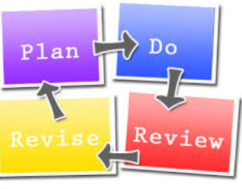
Revise
What have we done so far?
What problems have we solved?
What problems have we introduced in solving the problems?
Is there a better way of doing things?

Slide 44
Interfaces to the rescue?
Take the fly() method out of Duck superclass
And make a Flyable interface
Only those ducks that fly are required to implement the interface
Make a Quackable interface too
interface Flyable
fly()
Interface Quackable
quack()
class Duck
swim()
display()
//other duck-like methods…
MallardDuck
display()
fly()
quack()
RedHeadDuck
display()
fly()
quack()
RubberDuck
display() {
quack()

Slide 45
But there are some implications
Duplicate code for every duck type that can fly or quack. We have to implement fly() and quack() methods for all ducks that can fly or quack.
There are lot of duck types, so we have to call the methods carefully. As we are not sure which duck will have fly() method or quack (). We have to check against instanceOf or some other mechanism.
Looks like we have created a maintenance nightmare.
Re-thinking:
Inheritance has not worked well because
Duck behavior keeps changing
Not suitable for all subclasses to have those properties
Interface was at first promising, but
No code re-use
Tedious
Every time a behavior is changed, you must track down and change it in all the subclasses where it is defined
Error prone

Slide 46
Look at what Strategy Pattern says
Identify the aspects of your application that vary and separate them from what stays the same.
So what are variable in the Duck class?
Flying behavior
Quacking behavior
Pull these duck behaviors out of the Duck class
Create new classes for these behaviors
How to design such an implementation
Goal here is-
keep things flexible
Want to assign behaviors to instances of Duck
instantiate a new MallardDuck instance
Initialize it with a specific type of flying
Be able to change the behavior dynamically

Slide 47
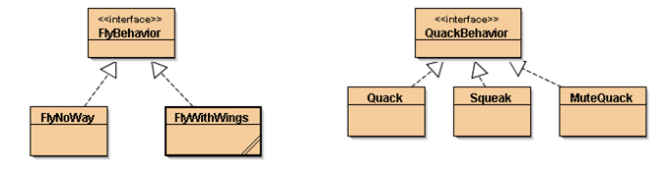
Next Step
Use a supertype to represent each behavior
FlyBehavior and QuackBehavior
Each implementation of a behavior will implement one of these supertypes
In the past, we rely on an implementation
In superclass Duck, or
A specialized implementation in the subclass
Now: Duck subclass will use a behavior represented in a supertype

Slide 48
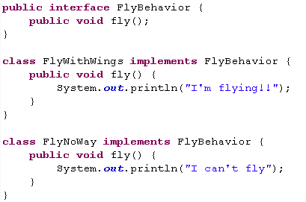
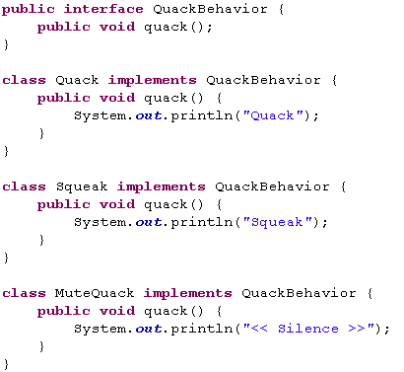
Some Code

Slide 49
Program to supertype
Program to a Supertype” means:
Exploit polymorphism by programming to a supertype
The actual runtime object isn’t locked into the code
The declared type of the variable should be a supertype, usually an abstract class or interface
Objects assigned to those variables can be of any concrete implementations of the supertype
The class declaring them need not know about the actual object type

Slide 50
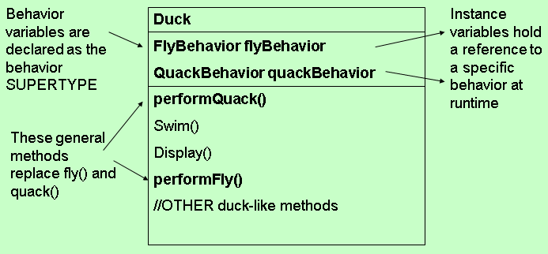
Integration with Duck
Program to a Supertype”:
Exploit polymorphism by programming to a supertype
The actual runtime object isn’t locked into the code
The declared type of the variable should be a supertype, usually an abstract class or interface
Objects assigned to those variables can be of any concrete implementations of the supertype
The class declaring them need not know about the actual object type
Integration-
Add 2 instance variables:

Slide 51
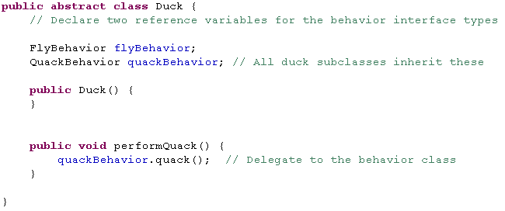
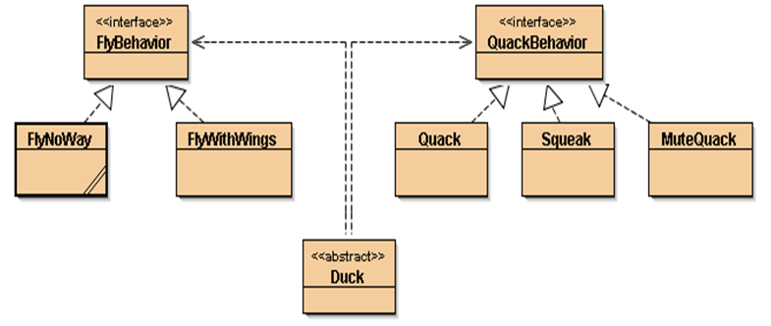
Implement performQuack()

Slide 52
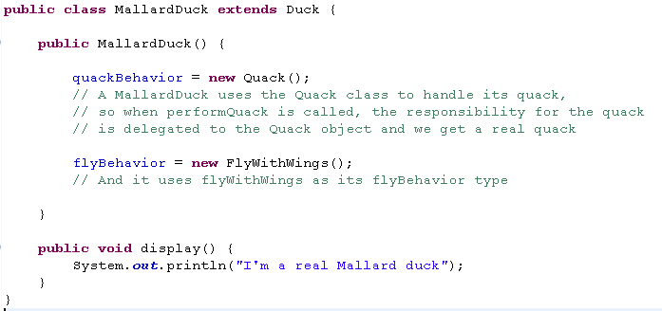
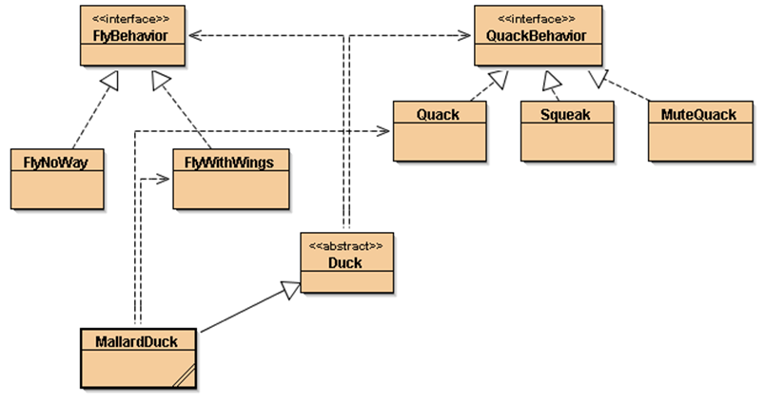
How to set the quackBehavior variable & flyBehavior variable

Slide 53
Testing the duck code
Type and compile:
Duck class and the MallardDuck class
FlyBehavior interface and the two behavior implementation classes (FlyWithwings.java and flyNoWay.java)
QuackBehavior interface and 3 behavior implementation classes
Test class (MiniDuckSimulator.java)
Check the code in below source file, for more references

Slide 54
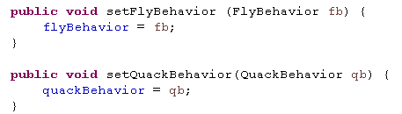
Check-in
We have built dynamic behavior in ducks e.g. a MallardDuck
The dynamic behavior is instantiated in the duck’s constructor
How can we change the duck’s behavior after instantiation?
Changing a duck’s behavior after instantiation
Set the duck’s behavior type through a mutator method on the duck’s subclass
Add new methods to duck class

Slide 55
Exercise
Add a new class ModelDuck. ModelDuck has no way to fly initially. Then enable ModelDuck to fly by using mutator setter method.
Make a new FlyBehavior type (FlyRocketPowered.java) which flies like a rocket.
Observe how flexible it is to new changes.

Slide 56
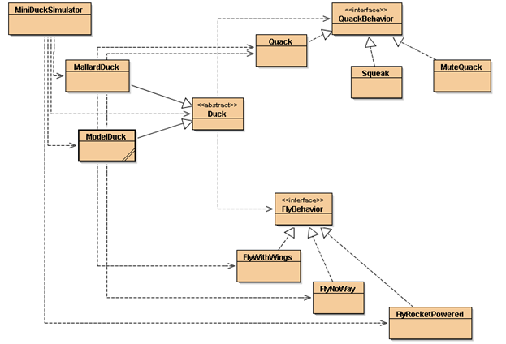
Final Class Diagram

Slide 57
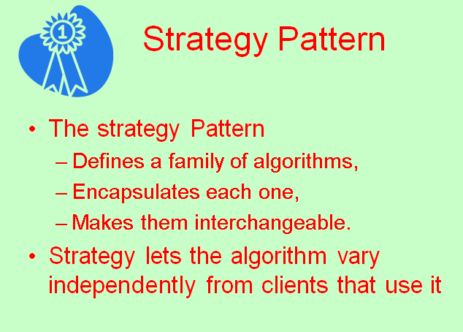
Summary
Reworked class structure
ducks extending Duck
fly behaviors implementing FlyBehavior
quack behaviors implementing QuackBehavior
Think of each set of behaviors as a family of algorithms
Relationships: IS-A, HAS-A, IMPELMENTS
Favor composition over inheritance
More flexibility
Encapsulate a family of algorithms into their own set of classes
Able to change behavior at runtime

Slide 58
Benefits of Strategy pattern
Reusability- Hierarchies of Strategy classes define a family of algorithms or behaviors for contexts to reuse
Strategies eliminate conditional (if-else) statements. The Strategy pattern offers an alternative to conditional statements for selecting desired behavior. So solution is more extendable and maintainable.
Inheritance offers another way to support a variety of algorithms or behaviors. You can subclass a Context class directly to give it different behaviors.
Encapsulating the algorithm in separate Strategy classes lets you vary the algorithm independently of its context, making it easier to switch, understand, and extend.
A choice of implementations. Strategies can provide different implementations of the same behavior. The client can choose among strategies with different time and space trade-offs.

Slide 59
Flaws of Strategy pattern
Clients must be aware of different Strategies. The pattern has a potential drawback in that a client must understand how Strategies differ before it can select the appropriate one.
Clients might be exposed to implementation issues. Therefore you should use the Strategy pattern only when the variation in behavior is relevant to clients.
Communication overhead between Strategy and Context. The Strategy interface is shared by all ConcreteStrategy classes whether the algorithms they implement are trivial or complex.
Increased number of objects. Strategies increase the number of objects in an application. Sometimes you can reduce this overhead by implementing strategies as stateless objects that contexts can share.

Slide 60
Command Pattern
Problem statement
Build a remote that will control variety of home devices
Sample devices: lights, stereo, TV, ceiling light, thermostat, sprinkler, hot tub, garden light, ceiling fan, garage door
Goal: To make a remote control that can extendible if there are more actions like (setTemp, increaseTemp etc. for an AC) to come for devices.
The best way to do this is through Command pattern where-
The requester of the action is decoupled from the object that actually performs the action.
That way it would remain generic to all the devices.

Slide 61
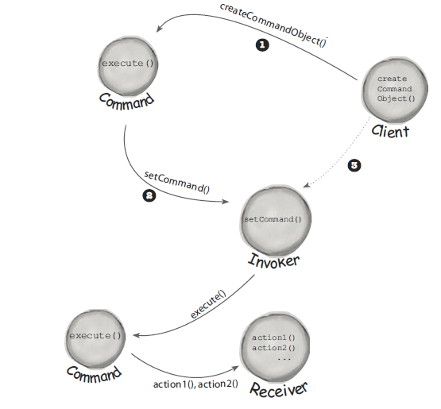
Command Pattern Flow
Parts of our design are:
The actions that we want each button to cause (Command)
Someone to set up those actions (Client)
The remote control to execute the actions (Invoker)
The device affected by the action (Receiver)

Slide 62
Command Pattern
Below is the command pattern UML diagram
Client
Invoker
setCommand()
<<interface>>
Command
execute()
undo()
Receiver
action()
ConcreteCommand
execute()
undo()
public void execute() {
receiver.action()
}

Slide 63

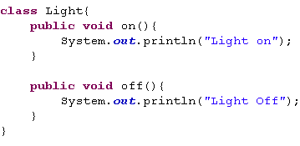
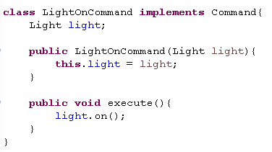
Implementation
Implementing the command interface
First Command Object- Turn on light command
Light Class

Slide 64
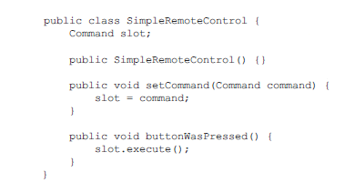
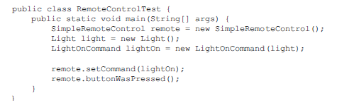
Using the Command Object
Usage
Simple test to use SimpleRemoteControl

Slide 65
Exercise
Implement the GarrageDoorOpenCommand and use it in the SimpleRemoteControl class.
See the code attached in Integration slide for solution.

Slide 66
Command Pattern Definition
The command pattern encapsulate a request as an object, thereby letting you to parameterize other objects with different requests, queue or log requests and support undoable operations.
Step through-
Command object encapsulate a request.
Receiver has parameterized objects. We replaced the Lights On command with Garage Door open command.
The commands can be put in a queue, say remote control having all the request.
The command done can be undo.
Let’s see the undo operation.
When a command support undo, they have undo() method as mirror to the execute() button.
Whatever execute() last do, undo() revert.

Slide 67

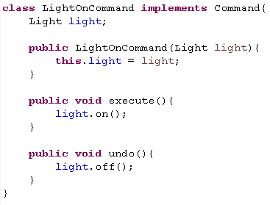
Undo support
Change the interface
Implement undo into Light Commands

Slide 68
Integration
Now integrate the undo command into your code and test it.
Exercise
Implement other commands for different devices and implement the remote controller to execute these commands.
Code-

Slide 69
Benefits of Command Pattern
Command decouples the object that invokes the operation from the one that knows how to perform it.
Commands are first-class objects. They can be manipulated and extended like any other object.
You can assemble commands into a composite command. In general, composite commands are an instance of the Composite pattern.
It's easy to add new Commands, because you don't have to change existing classes.
Ability to undo/redo easily.

Slide 70
Flaws of Command pattern
increase in the number of classes for each individual command.
Need to write a Command class for each operation.

Slide 71
Visitor Design pattern
Allows for new operations to be defined and used on elements of an object structure with out changing the contents of those elements.
The Key is Double Dispatch
Where it is applicable-
Rarely Changing Object Structures
Using Unrelated Operations
Many Classes with Differing Interfaces
Example-
you are going into shopping mall where you have different objects in your card. Now all these distinct objects are to go some similar operation billing() but with different offers on each of them.

Slide 72
Problem
Many distinct and unrelated operations need to be performed on objects in a heterogeneous aggregate structure.
You want to avoid "polluting" the classes with these operations.
you don't want to have to query the type of each node and cast the object to the correct type before performing the desired operation.

Slide 73
Discussion
Visitors primary purpose is to abstract functionality that can be applied to heterogeneous elements. The processing functionality is removed from original classes and new functionality can easily be added by creating new visitor sub class.
Double Dispatch-
OO messages generally manifest single dispatch. The operation depends upon- name of request and type of receiver. In double dispatch operation executed depends upon - the name of the request, and the type of TWO receivers (the type of the Visitor and the type of the element it visits).

Slide 74
Implementation
Two hierarchies – Visitor Hierarchy and Element Hierarchy.
Visitor class hierarchy that defines an abstract visit() method in the abstract base class for each concrete derived class. Each visit method accepts a single argument and that is reference to original element class.
Each implementation of Visitor hierarchy now contains visit () method for all the concrete class of original element.
In element hierarchy base class, provide a single abstract accept() method to receive a single argument – a reference to base class in visitor hierarchy.
Each concrete derived class of the Element hierarchy implements the accept() method by simply calling the visit() method on the concrete derived instance of the Visitor hierarchy that it was passed.
The accept() method causes flow of control to find the correct Element subclass. Then when the visit() method is invoked, flow of control is vectored to the correct Visitor subclass. accept() dispatch plus visit() dispatch equals double dispatch.

Slide 75
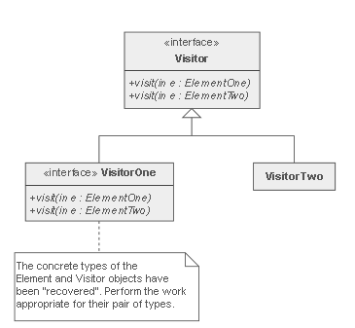
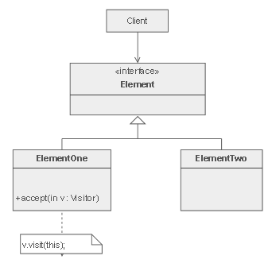
Structure
Element Hierarchy
Visitor Hierarchy

Slide 76
Real world example
Shopping in the supermarket is another common example, where the shopping cart is your set of elements. When you get to the checkout, the cashier acts as a visitor, taking the disparate set of elements (your shopping), some with prices and others that need to be weighed, in order to provide you with a total.
Problem Statement:
The example we'll use here is a postage system. Our set of elements will be the items in our shopping cart. Postage will be determined using the type and the weight of each item, and of course depending on where the item is being shipped to.

Slide 77

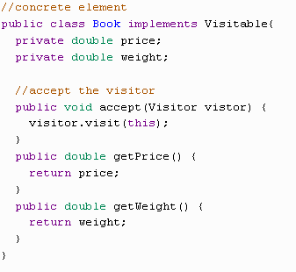
Implementation
Let’s first implement the Elements hierarchy (Visitable)
Let’s implement a concrete Book implementation of Visitable
TO DO: Implement other implementation of Visitable like – CD
DVD
Floppy
Kindle etc.

Slide 78
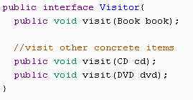
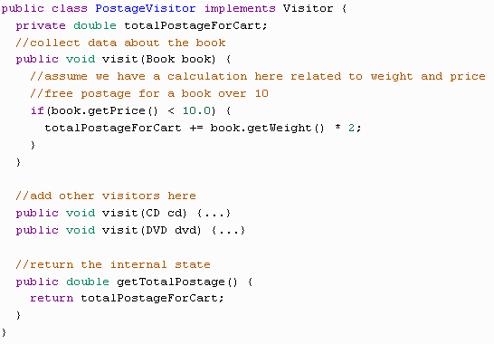
Implementation (Contd..)
Now move to our visitor interface
Implement PostageVisitor concrete class from Visitor interface

Slide 79
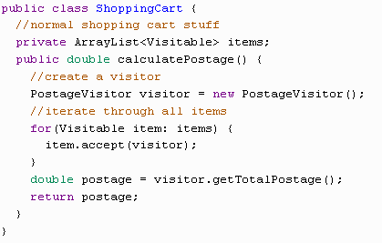
Implementation (Contd..)
And finally simulate the visitor for each element

Slide 80
Benefits of Visitor pattern
Visitor makes adding new operations easy. Visitors make it easy to add operations that depend on the components of complex objects.
You can define a new operation over an object structure simply by adding a new visitor. In contrast, if you spread functionality over many classes, then you must change each class to define a new operation.
A visitor gathers related operations and separates unrelated ones. Related behavior isn't spread over the classes defining the object structure
Any algorithm-specific data structures can be hidden in the visitor.
Visiting across class hierarchies. An iterator can visit the objects in a structure as it traverses them by calling their operations. But an iterator can't work across object structures with different types of elements.
Visitor does not have this restriction. It can visit objects that don't have a common parent class. You can add any type of object to a Visitor interface.

Slide 81
Watch Out for the Downsides
The arguments and return types for the visiting methods needs to be known in advance, so the Visitor pattern is not good for situations where these visited classes are subject to change. Every time a new type of Element is added, every Visitor derived class must be amended.
Also, it can be difficult to refactor the Visitor pattern into code that wasn't already designed with the pattern in mind. And, when you do add your Visitor code, it can look obscure. The Visitor is powerful, but you should make sure to use it only when necessary.
Adding new ConcreteElement classes is hard. The Visitor pattern makes it hard to add new subclasses of Element. Each new ConcreteElement gives rise to a new abstract operation on Visitor and a corresponding implementation in every ConcreteVisitor class.
This pattern often forces you to provide public operations that access an element's internal state, which may compromise its encapsulation.

Slide 82
Adapter Design Pattern
Suppose that you have existing software.
You have outsourced some of your work and there is a new library that needs to be added to the existing software.
Problem:
The interfaces of the new class library are different to that of the existing software.
The new class library cannot be changed as you do not have the source code.
Should you change the existing code?
Duck and Turkey Example-
Suppose that we have an interface for the type Duck and the type Turkey.
The Duck interface has the methods:
quack()
fly()
The Turkey interface has the methods
gobble()
fly()
How would you use Turkey objects as Duck objects?

Slide 83

Using an adaptor
We do not want to change the Duck interface or the Turkey interface.
So we write an adapter that can convert from one to the other.
To use a Turkey object as a Duck object you need to write a Turkey adapter.
The adapter must implement the Duck interface.
The adapter must redefine the quack() method and the fly() method

Slide 84
The adaptor pattern
Converts the interface of one class to another thus enabling classes with incompatible interfaces to work together.
There are two types of adapters:
Object adapters, e.g. the duck-turkey example
Class adapters
Write an adapter that converts a Duck to a Turkey

Slide 85
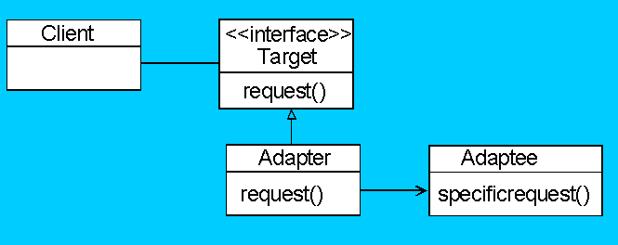
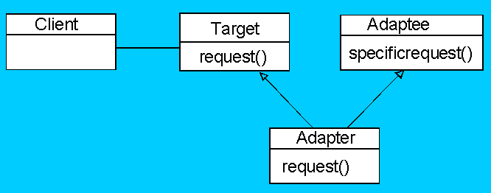
Adaptor Structures
Object Adapter Structure
Class Adaptor Structure

Slide 86
Example of Adapters used in Java
Collection classes in Java, e.g. Vector, Stack implement a method elements() which returns a the elements of the structure.
Older versions of Java return this as an Enumeration.
Later versions return the elements as an Iterator.
Both Enumeration and Iterator are interfaces.
An adapter will be needed to convert from one interface type to another.
Enumeration vs. Iterator
Enumeration interface methods:
hasNextElement()
nextElement()
Iterator interface methods:
hasNext()
next()
remove()
Draw a class diagram and write the code to adapt and Enumeration to an Iterator.

Slide 87
Class Diagram for the Enumeration Adapter
Class Diagram

Slide 88
How do we Implement the Adapter Pattern in this Case
Implement an EnumerationAdapter class.
This class will implement the Iterator interface.
Redefine the hasNext() method.
Redefine the next() method.
Redefine the remove() method?
Exercise
Write an adapter that converts an Iterator to an Enumeration
Summary
An adapter is used when one needs to use and existing class that does not have the interface that is needed.
The adapter pattern changes the interface to one the client expects.
Design Principle: Principle of least knowledge: Only talk to your friends.

Slide 89
Exercise
Create interfaces for Media Player and Advanced Media Player.
Create concrete classes implementing the AdvancedMediaPlayer interface
Create adapter class implementing the MediaPlayer interface.
Create concrete class implementing the MediaPlayer interface.
Use the AudioPlayer to play different types of audio formats.
Solution
https://javarevealed.wordpress.com/tag/adapter-pattern/

Slide 90
Advantages of Adaptor pattern
Encapsulated reuse of existing behavior.
Polymorphism (through an up-cast) with a foreign class.
Promotes the Open-Closed Principle.
If the construction of the foreign class was not encapsulated (which is common), the Adapter can encapsulate it in its constructor. However, an object factory is preferred.
Pluggable adapters. A class is more reusable when you minimize the assumptions other classes must make to use it.
Provide more flexibility.

Slide 91
Flaws of Adaptor pattern
It unnecessarily increases the size of the code as class inheritance is less used and lot of code is needlessly duplicated between classes.
Sometimes many adaptations are required along an adapter chain to reach the type which is required.

Slide 92
Prototype Pattern
A creational pattern
Specify the kinds of objects to create using a prototypical instance, and create new objects by copying this prototype
When to use Prototype pattern
When product creation should be decoupled from system behavior
When to avoid subclasses of an object creator in the client application
When creating an instance of a class is time-consuming or complex in some way.
When instances of a class can have one of only a few different combinations of state. It may be more convenient to install a corresponding number of prototypes and clone them rather than instantiating the class, each time with the appropriate state.

Slide 93
Prototype Pattern- Motivation
Sometimes, it becomes necessary to copy or clone an “already grown” object rather than instantiating it and setting its values.
Consider the case of Photoshop. A graphics designer add an image to the canvas. Then, he adds a border to it. Then, he gives it a bevel effect. Finally, he sets its transparency to 50%. Now, he selects this image, presses Ctrl + C , and press Ctrl + V 5 times.
What will happen? The same image will be pasted 5 times. So, there will be 6 identical images on the canvas at different locations.
How will you achieve this programmatically? New object from scratch at client side? Use a factory?
Prototype patterns is the solution here.

Slide 94
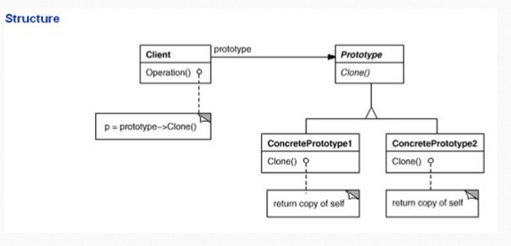
Prototype - Structure
Structure

Slide 95
Prototype- Participant
Prototype
Declares an interface for cloning itself.
ConcretePrototype
Implements an operation for cloning for itself.
Client
Creates a new object by asking a prototype to clone itself.

Slide 96
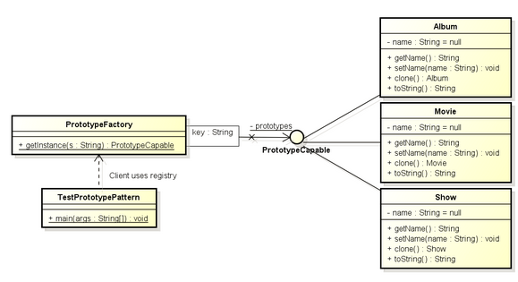
Prototype – Problem
Create an entertainment application that will require instances of Movie, Album and Show classes very frequently. I do not want to create their instances every time as it is costly. So, I will create their prototype instances, and every time when i will need a new instance, I will just clone the prototype.

Slide 97


Prototype - Solution
Solution
PrototypeCapable
Movie

Slide 98

Practice
Create two other classes Album and show as per the class diagram in upper slides.
Create ProtoTypeFactory class-

Slide 99

Test
Below is the test class

Slide 100
Prototype - Consequnces
Prototype has many of the same consequences that Abstract Factory and Builder have. It hides the concrete product class from the client, thereby reducing the number of names of clients know about. Moreover, these patterns let a client work with application-specific classes without modification.
Reducing sub classing. Factory method often produces a hierarchy of Creator classes. Prototype patterns lets you clone a prototype instead of asking a factory method to make a new object. Hence you don’t need a Creator class hierarchy at all..
Configuring an application with classes dynamically. Some run-time environments let you load classes into an application dynamically.
Additional benefits of the prototype patterns are-
Adding and removing products at run-time. Prototypes let you incorporate a new concrete product class into a system simply by registering a prototypical instance with the client.
Specifying new objects by varying values. Highly dynamic systems let you define new behavior through object composition- by specifying values for an object’s variables, You effectively define new kinds of objects by instantiating existing class and registering the instances as prototypes of client objects.
Specifying new objects by varying structures. Many application build objects from parts and subparts.

Slide 101
Prototype- Flaws
The main liability of the Prototype pattern is that each subclass of Prototype must implement the Clone operation, which may be difficult.
Implementing Clone can be difficult when their internals include objects that don’t support copying or have circular references.

Slide 102
Assignment
We need a car decorating application. This application lets user to choose from a pool of cars, and then decorate its body, wheel and engine with various color and accessories as we see in the NFS game
At any point of designing- the user can
Create a copy of the care
Keep the half designed car aside
Continue to design on the newly created one
Compare these differently designed cars at the final stage so that he can efficiently pick the one that looks best.

Slide 103
MVC (Model View Controller) pattern
Model View Controller or MVC as it is popularly called, is a software desing pattern for developing we applications.
MVC is a software architecture pattern which separates the representation of information from the user’s interaction with it.
A model view controller pattern is made up of the following three parts:
Model
View
Controller

Slide 104


Parts of MVC
The MVC model defines web aplications with 3 logic layers:
The business layer (Model Layer)
The display layer (View Logic)
The input control (Controller Logic)

Slide 105
Model
The model is responsible for managing the data of the application.
It responds to the request from the view and it also responds to instructions from the controller to update itself
It is the lowest level of the pattern which is responsible for maintaining data.
The model represents the application core (for instance a list of database records).
Its is also called the domain layer.

Slide 106
View
The View displays the data.
A view request information from the model, that it needs to generate an output representation.
It represent data in a particular format like JSP, ASP, PHP.
MVC is often seen in web applications, where the view is the HTML page.

Slide 107
Controller
The controller is the part of the application that handles user interaction.
Typically controllers read data from a view, control user input, and send input data to the model.
It handles the input, typically user actions and may invoke changes on the model and view.

Slide 108
Workflow in MVC
Though MVC comes in different flavors, the control flow generally works as follows:
The user interacts with the user interface in some way (e.g. user presses a button)
A controller handles the input event from the user interface. Often view a registered handler or callback.
The controller accesses the model, possibly updating it in a way appropriate to the user’s action (ex- controller updates user’s shopping cart).
A view uses the model to generate an appropriate user interface (ex- view produces a screen listing the shopping cart contents).
The view gets its own data from the model. The model has no direct knowledge of the view.
The user interface waits for further user interactions, which begins the cycle anew.

Slide 109
Dependency Hierarchy
There is usually a kind of hierarchy in the MVC pattern.
The model knows only about itself.
That is, the source code of the Model has no reference to either the View or Controller.
The View however, knows about the Model. It will poll the Model about the state, to know what to display.
That way, the View can display something that is bases on what the Model has done.
But the View knows nothing about the Controller.
The controller knows about both the Model and the View.

Slide 110
Dependency hierarchy (Contd..)
Take an example from a game: if you click on the fire button on the mouse, the Controller knows what fire function in the Model to call.
If you press the button for switching between first and third person, the Controller knows what function in the view to call to request the display change.
Why dependency hierarchy is used?
The reason to keep it this way is to minimize dependencies.
No matter how the view class is modified, the Model will still work.
Even if the system is moved from a desktop operating system to a smart phone, the Model can be with no changes.
But the view probablly needs to be updated, as will the Controller.

Slide 111
Uses in Web applications
Although originally developed for personal computing, Model View Controller has been widely adapted as an architecture for World Wide Web applications in all major programming languages.
Several commercials and non-commercial applications frameworks have been created that enforce the pattern.
These frameworks vary in their interpretations, mainly in the way that the MVC responsibilities are divided between the client and server.
Early web MVC frameworks took a thin client approach that placed almost the entire model, view and controller logic on the server.
In this approach, the clients sends either hyperlink requests or form input to the controller and then received a complete and updated web page from the view; the model exists entirely on the server.
As client technologies have matured, frameworks such as JavaScript MVC and backbone have been created that allow the MVC components to execute partly on the client.

Slide 112

Working of MVC in web application
Working diagram of MVC

Slide 113
Advantages
Clear separation between presentation logic and business logic.
Each object in the MVC have distinct responsibilities.
Parallel development.
Easy to maintain and future enhancements
All objects and classes are independent of each other.

Slide 114
Disadvantages
Increased complexity
Inefficiency of data access in view
Difficulty of using MVC with modern user interface too.
For parallel development there is a needed multiple programmers.
Knowledge on multiple technologies is required.

Slide 115
Recap
Singleton Pattern
Only one object is allowed to instantiate.
Synchronized and double check lock to make it thread safe.
Early initialization can save you from synchronization over head.
Enum is best way but lesser popular to implement Singleton.
Factory Pattern
Handles object creation when many instantiations makes updates and hence maintenance is difficult and error-prone.
Defines an interface to create objects, but let subclasses decide which type of object to create.
defines parallel class hierarchy - Creator hierarchy and Product hierarchy
provide a creator method in creator class like createPizza().
Use Abstract Factory Pattern to create a family of products.

Slide 116
Recap (Contd..)
Strategy pattern
Don't overuse inheritance- adding new method becomes difficult.
Can't rely always on interfaces- hamper code reusability and code becomes error prone.
Identify the aspects of your application that vary and separate them from what stays the same.
Prefer Composition over inheritance.
Code to interface and not to implementation.
Command Pattern
Remote control to execute different commands
Four player- Client, Invoker, Command, Receiver.
Client creates and set the command to invoker. where invoker invokes the execute() method.
Command pattern basically encapsulate a request.
Don't forget to add the undo() functionality.

Slide 117
Recap (Contd..)
Visitor Pattern
New operations to be defined and used on elements of an object structure with out changing the contents of those elements.
The Key is Double Dispatch
Shopping cart is good example
Two hierarchies- Visitor and Visitable (Element)
Each visitalbe has accept() method with concrete respective Visitor.
Concrete Visitors has visit() method for each concrete element.
Adaptor Pattern
An inteface for conversion between two different interfaces like Duck and Turkey interface.
Two types of adaptors
object adaptors
class adaptors
Enumeration and Iterator is an Adaptor example from JAVA.

Slide 118
Recap (Contd..)
Prototype pattern
A creational pattern
Specify the kinds of objects to create using a prototypical instance, and create new objects by copying this prototype
When to use Prototype pattern
When product creation should be decoupled from system behavior
When to avoid subclasses of an object creator in the client application
When creating an instance of a class is time-consuming or complex in some way.

Slide 119
Recap(Contd..)
MVC pattern
Model View Controller
Used majorly in Web Applications
The user interacts with the user interface in some way (e.g. user presses a button)
A controller handles the input event from the user interface. Often view a registered handler or callback.
The controller accesses the model, possibly updating it in a way appropriate to the user’s action (ex- controller updates user’s shopping cart).
A view uses the model to generate an appropriate user interface (ex- view produces a screen listing the shopping cart contents).
The view gets its own data from the model. The model has no direct knowledge of the view.

Slide 120
References
Head First Design patterns.
http://www.tutorialspoint.com/design_pattern/
https://dzone.com/articles/design-patterns-visitor

Slide 121
THANK YOU

